Slide 1
Computer Networks _22CS008
Transport layer
Lecture ( 51-52)
Prepared By
Dr. Kiran Deep Singh
Department of Computer Science and Engineering,
Chitkara University, Punjab

Slide 2
Index
Introduction
Services
Connectionless and Connection Oriented protocol
Transport Layer Protocols
TCP Connection

Slide 3
Introduction
The transport layer of the TCP/IP model handles data transfer between applications on different devices. Two main protocols are used:
Transmission Control Protocol (TCP): This is a connection-oriented protocol, meaning it establishes a connection between sender and receiver before data transfer. TCP ensures reliable delivery by breaking data into segments, checking for errors, and retransmitting lost packets. It's ideal for applications requiring guaranteed delivery, like file downloads and email.
User Datagram Protocol (UDP): This is a connectionless protocol, meaning it sends data packets without establishing a connection. UDP prioritizes speed over reliability, making it suitable for real-time applications like online gaming and streaming where occasional packet loss is acceptable.
Transfer Scheduling Functionality: Some applications might have built-in functionality for scheduling transfers to happen later. This could involve:
Download Managers: These programs allow users to queue downloads and schedule them to start at specific times, optimizing bandwidth usage.
Cloud Storage Services: Services like Dropbox and Google Drive often offer features for scheduling file uploads or syncing folders at specific times.
Email Clients: Some email clients allow scheduling emails to be sent at a later date and time.

Slide 4
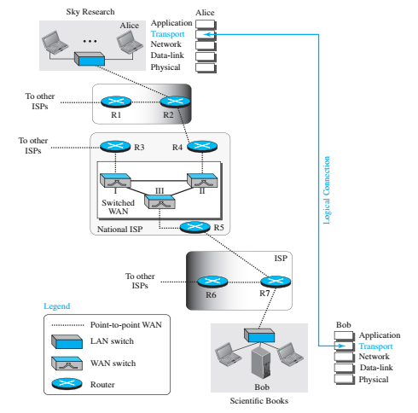
Introduction..
Locates between the application layer and the network layer.
Provides a process-to-process communication between two application layers, one at the local host and the other at the remote host.
Figure1: ﻿Logical connection at the transport layer.

Slide 5
Introduction. Working
﻿﻿Figure 1 shows a scenario in which a scientist working in a research company, Sky Research, needs to order a book related to her research from an online bookseller, Scientific Books.
﻿Five different levels of communication between Alice, the computer on which the scientist is working, and Bob, the computer that provides online service.
Communication at application, transport, network, or data-link is logical; communication at the physical layer is physical.
For simplicity, only ﻿host-to-router, router-to-router, and router-to-host are shown, but the switches are also involved in the physical communication.
Although Alice and Bob need to exchange data, communication at the physical layer means exchanging signals. Data need to be transmitted and received, but the media have to change data to signals.
Both data and the signals that represent them can be either analog or digital in form.

Slide 6
Transport Layer Services
Process to Process Communication
Addressing
Encapsulation and Decapsulation
Flow Control
Error Control
Congestion Control

Slide 7
Transport Layer Services…
Process to Process Communication
﻿A transport-layer protocol is responsible for delivery of the message to the appropriate process of destination computer.
Addressing
﻿ The most common way to achieve process-to-process communication is through the client-server paradigm.
A process on the local host (client), needs services from a process usually on the remote host (server).
For communication, the local host and the remote host are defined using IP addresses. To define the processes, second identifiers, called port numbers are also required.
Computer Networks

Slide 8
Transport Layer Services…
Encapsulation and Decapsulation
﻿Encapsulation happens at the sender site. When a process has a message to send, it passes the message to the transport layer. The transport layer receives the data and adds the transport-layer header. The packets at the transport layer in the Internet are called user datagrams, segments, or packets, depending on what transport-layer protocol.
﻿Decapsulation happens at the receiver site. When the message arrives at the destination transport layer, the header is dropped and the transport layer delivers the message to the process running at the application layer.

Slide 9
Transport Layer Services…
Flow Control
Whenever an entity produces items and another entity consumes them, there should be a balance between production and consumption rates.
If the items are produced faster than they can be consumed, the consumer can be overwhelmed and may need to discard some items. If the items are produced more slowly than they can be consumed, the consumer must wait, and the system becomes less efficient. Flow control is related to the first issue.
﻿Error control at the transport layer is responsible for
Detecting and discarding corrupted packets.
Keeping track of lost and discarded packets and resending them.
Recognizing duplicate packets and discarding them.
Buffering out-of-order packets until the missing packets arrive.

Slide 10
Transport Layer Services…
Congestion Control
﻿ Congestion in a network may occur if the load on the network, the number of packets sent to the network, is greater than the capacity of the network, the number of packets a network can handle.
Congestion control refers to the mechanisms and techniques that control the congestion and keep the load below the capacity
Computer Networks

Slide 11
Connection-less & Connection-oriented
At the transport layer, a logical connection between two transport layers is concerned rather than physical paths of packets
Two Types of Services
Connection-less Service
Connection-oriented Service

Slide 12
Connection-less Services
Connection-less Service
The source process (application program) needs to divide its message into chunks of data of the size acceptable by the transport layer and deliver them to the transport layer one by one
﻿Treats each chunk as a single unit without any relation between the chunks.
When a chunk arrives from the application layer, the transport layer encapsulates it in a packet and sends it.
To show the independency of packets, assume that a client process has three chunks of messages to send to a server process.
The chunks are handed over to the connectionless transport protocol in order.
However, since there is no dependency between the packets at the transport layer, the packets may arrive out of order at the destination and will be delivered out of order to the server process

Slide 13
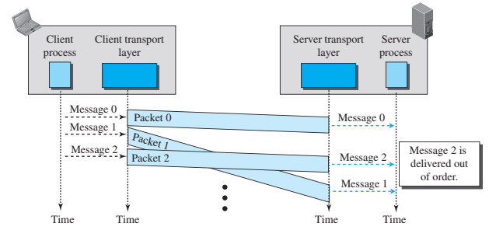
Connection-less Services…
Figure1: Connection-less Service.

Slide 14
Connection-oriented Services
Connection-oriented Service
﻿The client and the server first need to establish a logical connection between themselves
﻿The data exchange can only happen after the connection establishment. After data exchange, the connection needs to be torn down
﻿Transport layer connection-oriented service involves only the two hosts; the service is end to end.
﻿Flow control, error control, and congestion control can be implemented in a connection oriented protocol.

Slide 15
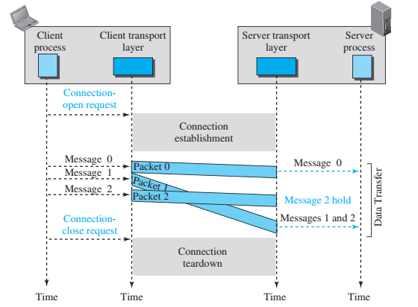
Connection-oriented Services..
Figure2: Connection-oriented Service

Slide 16
Transmission Control Protocol (TCP)
﻿A TCP connection provides a full-duplex service: If there is a TCP connection between Process A on one host and Process B on another host, then application layer data can flow from Process A to Process B at the same time as application layer data flows from Process B to Process A.
A TCP connection is also always point-to-point, that is, between a single sender and a single receiver.
﻿The client first sends a special TCP segment; the server responds with a second special TCP segment; and finally the client responds again with a third special segment.
The first two segments carry no payload, that is, no application-layer data; the third of these segments may carry a payload. Because three segments are sent between the two hosts, this connection-establishment procedure is often referred to as a three-way handshake.

Slide 17
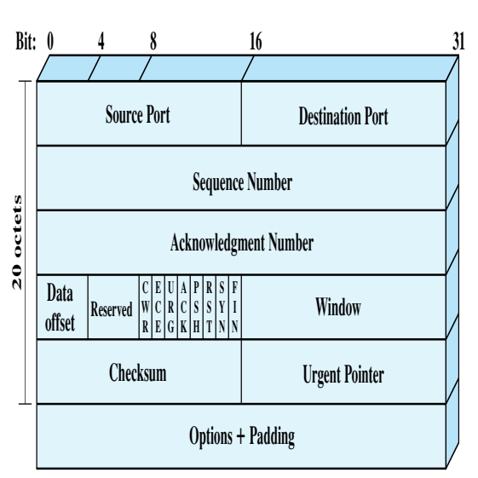
Transport Layer Protocols..
TCP Header

Slide 18
Transport Layer Protocols..
﻿﻿Source Port (16 bits): Source TCP user. Example values are Telnet 23; ﻿
TFTP = 69; HTTP = 80
Destination Port (16 bits): Destination TCP user.
Sequence Number (32 bits): Sequence number of the first data octet in this segment except when the SYN flag is set. If SYN is set, this field contains the initial sequence number (ISN) and the first data octet in this segment has sequence number ISN + 1
﻿Acknowledgment Number (32 bits): Contains the sequence number of the next data octet that the TCP entity expects to receive.
Data Offset (4 bits): Number of 32-bit words in the header.
Reserved (4 bits): Reserved for future use.

Slide 19
Transport Layer Protocols..
Flags (6 bits): For each flag, if set to 1, the meaning is
CWR: congestion window reduced.
ECE: ECN-Echo; the CWR and ECE bits, are used for the explicit congestion notification function
URG: urgent pointer field significant.
ACK: acknowledgment field significant.
PSH: push function.
RST: reset the connection.
SYN: synchronize the sequence numbers.
FIN: no more data from sender

Slide 20
Transport Layer Protocols..
﻿Window (16 bits): Flow control credit allocation, in octets. Contains the number of data octets, beginning with the sequence number indicated in the acknowledgment field that the sender is willing to accept.
Checksum (16 bits): The ones complement of the ones complement sum of all the 16-bit words in the segment plus a pseudo header, described subsequently.
Urgent Pointer (16 bits): This value, when added to the segment sequence number, contains the sequence number of the last octet in a sequence of urgent data. This allows the receiver to know how much urgent data is coming.
Options (Variable): An example is the option that specifies the maximum segment size that will be accepted.

Slide 21
TCP Connection
A TCP connection is the foundation for reliable data transfer over a network like the internet.
Key aspects:
Connection-Oriented: Unlike UDP (User Datagram Protocol), TCP establishes a connection between sender and receiver before data transfer. This ensures both parties are ready and resources are allocated for communication.
Three-Way Handshake:
SYN (Synchronize): The sender initiates by sending a segment with the SYN flag set. This includes a random initial sequence number (ISN) for data packets.
SYN-ACK (Synchronize-Acknowledge): The receiver responds with a segment containing its own ISN, the SYN flag set, and an acknowledgment (ACK) for the sender's ISN.
ACK: Finally, the sender sends an ACK segment acknowledging the receiver's ISN. This completes the handshake and establishes the connection.

Slide 22
TCP Connection..
Reliable Data Transfer:
TCP segments data into packets with sequence numbers for proper order reconstruction at the receiver's end.
The receiver sends acknowledgment (ACK) packets for received segments.
If the sender doesn't receive an ACK within a timeout period, it retransmits the missing segment.
This ensures all data arrives at the receiver correctly and in order.
Flow Control:
TCP uses a window mechanism to control the flow of data. The receiver advertises a window size indicating how many bytes it's ready to receive.
The sender transmits data within the advertised window to avoid overwhelming the receiver.
Full-Duplex Communication:
Both sender and receiver can send and receive data simultaneously, similar to a two-way conversation.

Slide 23
TCP Connection..
TCP Header:
Each TCP segment includes a header containing various control information:
Sequence and acknowledgment numbers for data tracking.
Flags like SYN, ACK, and FIN (Finish) for connection management.
Window size for flow control.
Termination:
To close the connection, either party can send a segment with the FIN flag set, indicating it's finished sending data.
The other party acknowledges the FIN and then sends its own FIN to signal it's done as well.
After acknowledgments are exchanged for both FINs, the connection is closed.

Slide 24
TCP Connection..
Benefits of TCP Connections:
Reliable data delivery with error checking and retransmission.
Ordered data transfer for maintaining data integrity.
Flow control to prevent overwhelming the receiver.
Full-duplex communication for efficient data exchange.
Applications using TCP:
Web browsing (HTTP)
File transfer (FTP)
Email (SMTP)
Secure communication (HTTPS)
By establishing a reliable connection with error correction and flow control, TCP is the workhorse protocol for applications requiring guaranteed and ordered data delivery across networks.

Slide 25
User Datagram Protocol (UDP)
﻿UDP provides a connectionless service for application-level procedures.
Thus, UDP is basically an unreliable service; delivery and duplicate protection are not guaranteed.
However, this does reduce the overhead of the protocol and may be adequate in many cases.

Slide 26
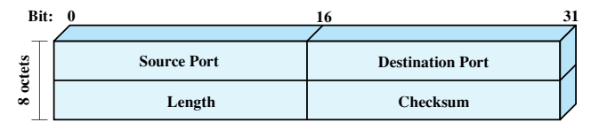
User Datagram Protocol (UDP)..
UDP Header
﻿The header includes a source port and destination port.
The Length field contains the length of the entire UDP segment, including header and data.
The checksum is the same algorithm used for TCP and IP.
For UDP, the checksum applies to the entire UDP segment plus a pseudoheader prefixed to the UDP header at the time of calculation and which is the same pseudoheader used for TCP.
If an error is detected, the segment is discarded and no further action is taken.
The Checksum field in UDP is optional. If it is not used, it is set to zero.

Slide 27
Practice Questions
Which of the following statements is TRUE about TCP connections?
They are connectionless and data is sent without establishing a connection. on
They guarantee reliable and ordered delivery of data. ✓
They prioritize speed over reliability and are best for real-time applications.
They require no acknowledgment from the receiver for sent data.
The three-way handshake in TCP involves which of the following steps?
Sender sends SYN, receiver sends ACK, sender sends FIN.
Sender sends SYN, receiver sends SYN-ACK, sender sends ACK. ✓
Sender sends ACK, receiver sends SYN, sender sends SYN-ACK.
Receiver sends SYN, sender sends SYN-ACK, receiver sends ACK
How does TCP ensure reliable data transfer?
By compressing data packets for faster transmission.
By using error correction codes and retransmitting lost packets. ✓
By prioritizing real-time delivery over accuracy.
(d) By relying solely on acknowledgments from the receiver

Slide 28
References
https://pinoybix.org/2017/07/mcq-in-network-layer-internet-protocol-forouzan.html
https://edurev.in/course/quiz/attempt/-1_Test-Ipv4--IP-Packet/0decdb37-7206-4824-afdd-d47013a5c4cd
https://www.geeksforgeeks.org/what-is-transmission-control-protocol-tcp/

